Slide 1
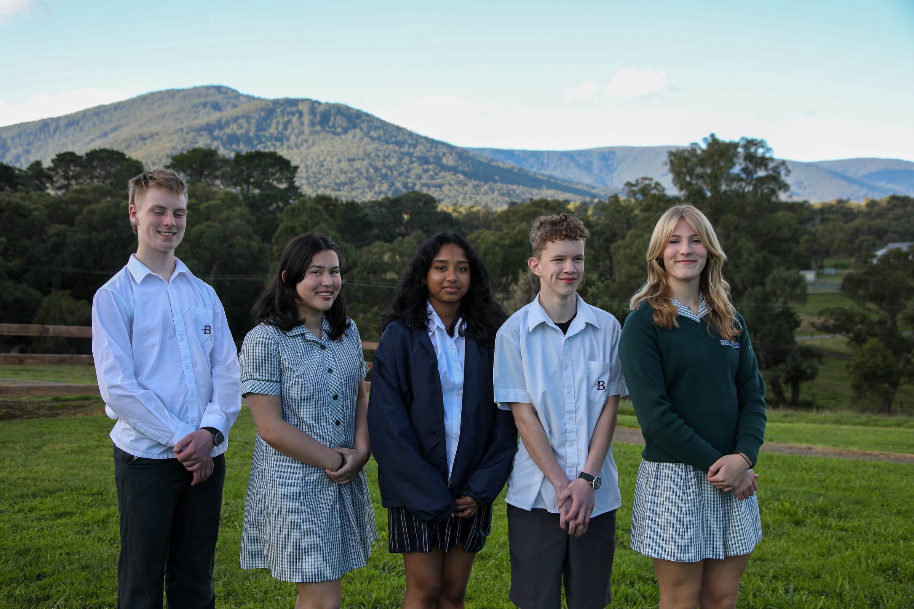

Slide 2
Brentwood Secondary College
INTRODUCTION TO SCHOOL
Founded in 1969 Brentwood Secondary Collage is a co-educational public high school located in the eastern Melbourne suburb of Glen Waverley, within the city of Monash. Brentwood currently had over 1,600 students enrolled all with various cultural backgrounds. Our school is a supportive and accepting environment which provides their students with the best opportunities to set them up for the future. With various programs such as Duke of Ed, Aviation and more, Brentwood has subjects and extra curriculars to push everyone to their full potential.
TEAM INTRO
We are the 5 students from Brentwood Secondary who got accepted into the Don Valley School for Student Leadership. We are all truly grateful to be selected by our school to attend this once in a life time opportunity to improve our leadership skills and understand ourselves as individuals. Through this experience we created stronger bonds with each other and approach problems as a team. Our community learning project is a school fair to help the RSPCA. We chose this because we all have a passion for helping animals and a strong dislike for the neglect of them. The five of us, Neha, Aya, Charlie, Cadel and Tayla are passionate about developing our Community Learning Project. We are determined to raise a major profit which can go towards helping the RSPCA’s animals and improving their facilities.

Slide 3
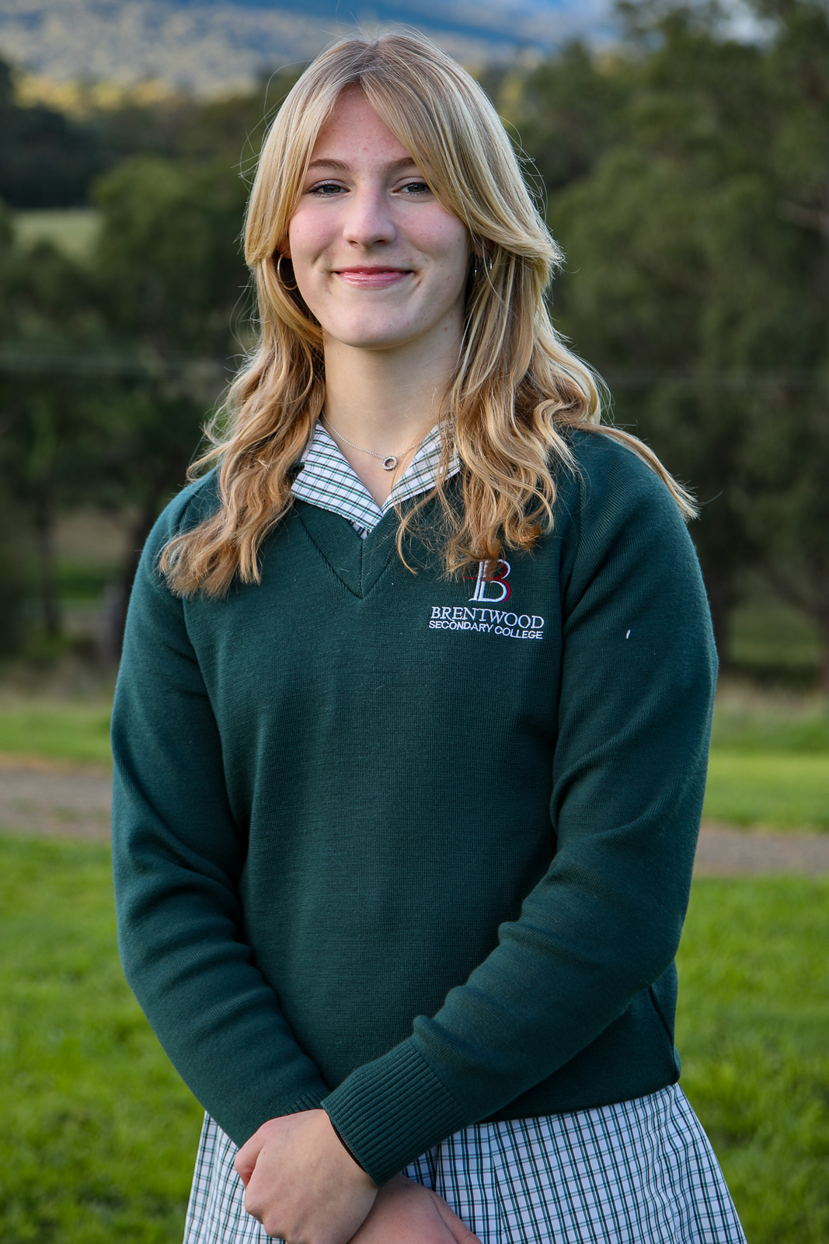
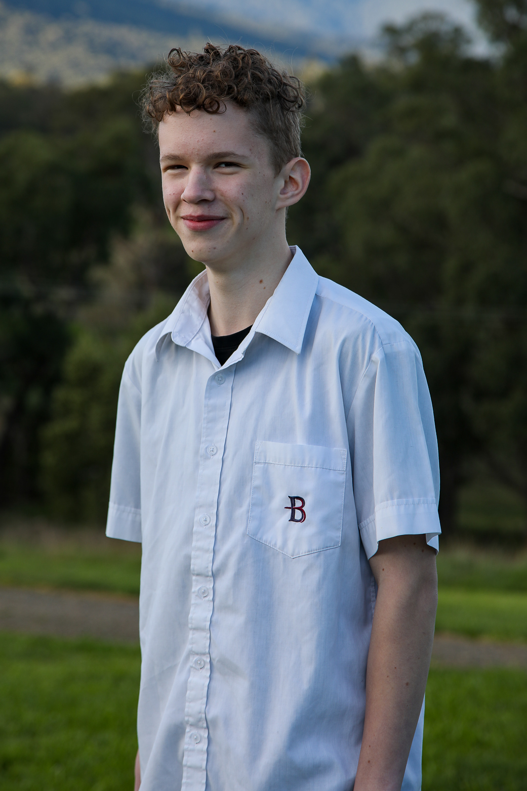
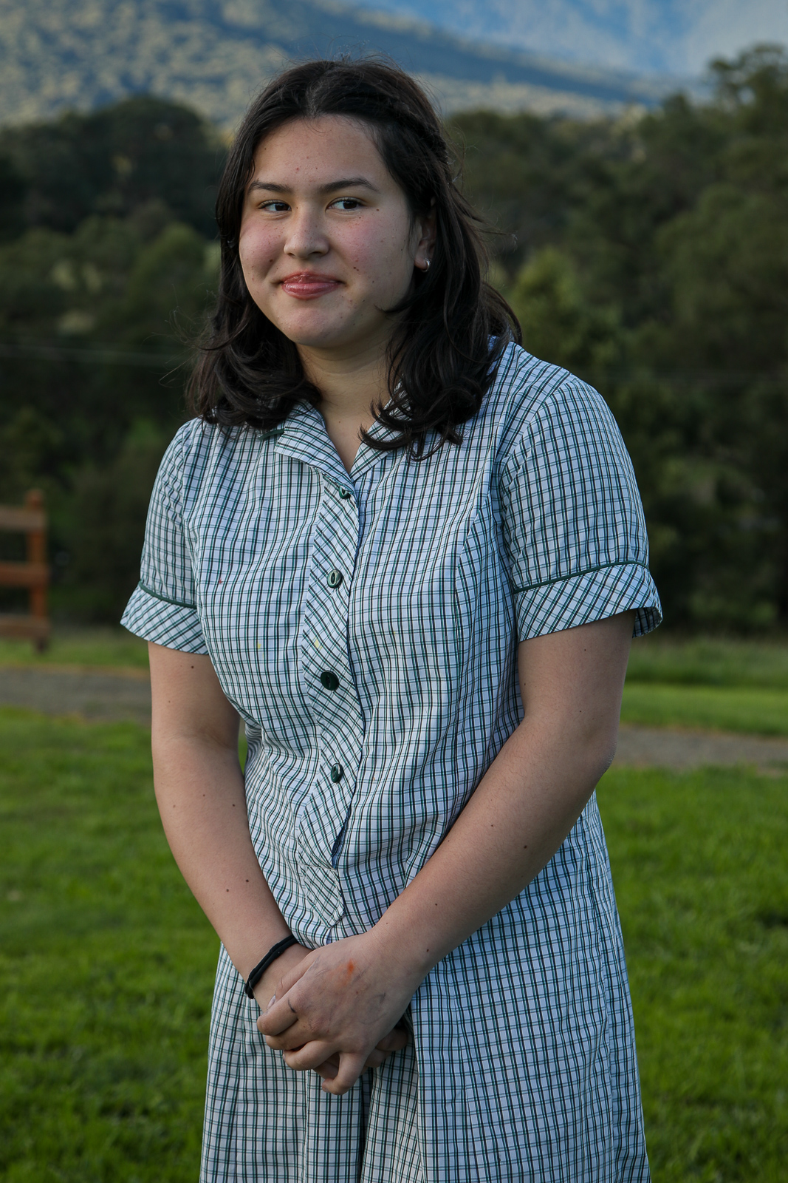
Meet Our Team 1
 | Tayla Meyers Hi, my name is Tayla Meyers and I am 14 years old. I live in Rowville with my mum, dad, brother and dog and I attend Brentwood Secondary College. Outside of school my interests include playing football and basketball, coaching my boys’ basketball team, cooking, travelling and helping animals. I think our project will be beneficial for a lot of people and animals as not only will it raise funds for the RSPCA, but it will also help publicize it more in our area and hopefully increase the adoptions. Although it’s already a big organization, RSPCA is not for profit and there are still millions of animals coming in every year so we believe it is very important to support and help out where we can which is what we hope to do.
 | Charlie Sherwin My name is Charlie Sherwin, I am a 15 years old and attend Brentwood secondary college. I live in Scoresby with my older brother and sister, as well as my two dogs and parents. In my free time I play the clarinet and I practice Muay Thai, which is a form of martial art. I’m grateful for this opportunity at SSL, and am hoping that this journey will help me further develop my leadership skills. I strongly believe that this CLP will benefit animals through our donations to the RSPCA. I’ve grown up loving animals and am glad to have a chance to be of help to animals in need.
 | Aya Van Schie Hello my name is Aya Van Schie and I’m 15 years old. I live in a suburb called glen Waverley. My hobbies are socializing, listening to music and mostly creative things I tend to pick a new hobby every 2 months. The reason why I came on to this school is because I want to gain confidence in my leadership skills as I want be police officer in the future. I have a family of 4 (actually 5 if you include my dog) I go to Brentwood which is 5-minute walk away from my home which is very convenient for me. I think the sausage sizzle will be beneficial because it raises money for the neglected animals in the RSPCA and the animals could really use some extra money.

Slide 4
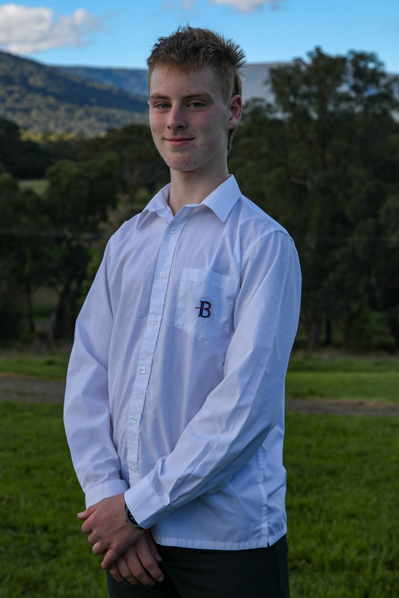
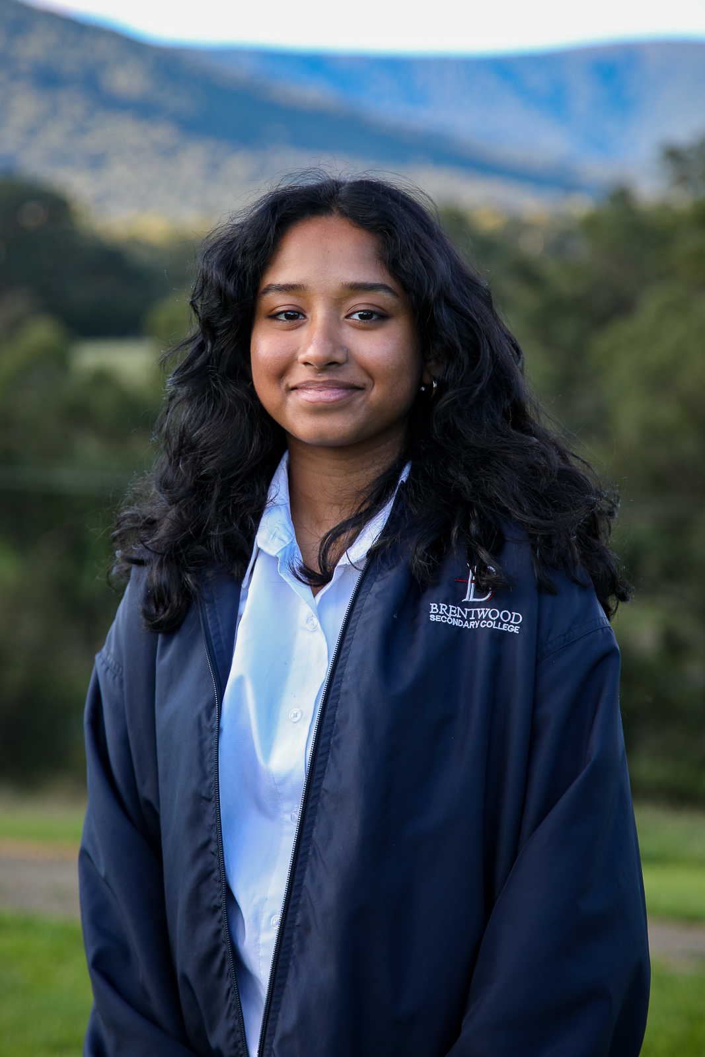
Meet Our Team 2
 | Cadel Knowles Hello, my name is Cadel Knowles and I am a 14-year-old Brentwood Secondary College student. I turn 15 on the 7th of September during which I will be spending my day with my amazing peers here at the SSL. I live with both my dad in Notting Hill, and my mum in Scoresby. In my youth I played Basketball and did Swimming, but now I am coaching a girls’ under 14s Basketball team. I am also preparing to start playing Footy in my free time as well. I spend most of my free time researching random facts about the world as well as practicing my creativity. I have a love for all animals and that is why I am very passionate about our CLP this term. I believe that any animal suffering is an animal too many, hence I believe that the more funds to the RSPCA the better.
 | Neha Raj Hi, my name is Neha Raj. I was born in Singapore and moved to Australia 4 years ago in 2019. I love to play badminton and cook. I live in a family of four which includes my mum, dad, brother and me. I like to challenge myself and expand my comfort zone. I am grateful to be chosen to participate in the School for Student Leadership program and I hope to improve my leadership skills overtime. I think this would be beneficial to our local RSPCA by providing funds and awareness.

Slide 5
Project Overview
Rationale
We chose the RSPCA, as we are very passionate about animals, and believe that they should always have their basic needs met. When it comes to animal welfare, the RSPCA have been the frontrunner out of all the various organizations, and are the most trusted of all the options.
Vision
The vision of our CLP, is to raise funds for the RSPCA. We plan to achieve this through the running of a sausage sizzle as well as a raffle; the winner of said raffle getting a chance to visit the RSPCA on an excursion. We will run these activities on Brentwood’s term 4 community day, and 100% of profits will be directed towards the RSPCA. The RSPCA is a not-for-profit organization that provides support for animals in need, and relies solely on the generosity of donors such as ourselves.
Summary
For our sausage sizzle, we are using the standard quantities used by Brentwood. This consists of: 1300 sausages ($648), 72 loaves of bread ($173), vegetarian/vegan allowance ($100). This totals out to $921, and the expected sales, based off previous events, is approximately $2700, this leaves an estimated $1780 of profits from the sausage sizzle alone. Furthermore, we are running a raffle, with the prize being an excursion tour of the RSPCA. Whilst we have little idea what the profits of such an event would be, we can assume that it will increase our overall profit.

Slide 6
Action Plan 1
Plan | Confirm what all stalls will be doing Contact RSPCA and get their support Figure out numbers of how much of everything we will need Talk to Ms Saathoff and school at home Figure out date and location to host fair Figure out date for RSPCA volunteer day
Promote | Create Posters to advertise the fair and volunteer day Create donations bucket design Organise and present the day to our school prior via assembly Publicize raffle
Prepare | Contact RSPCA and talk them through what we are doing Get sponsorship and donations from Woolworths/Coles Bake the sweets for bake sale Set up donation’s bucket
Do | Set up stalls in hardcourt Cook sausages Sell baked goods, sausages and drinks Draw the raffle one tickets have been purchased Spend a day volunteering at the RSPCA
Donate | Donate funds to RSPCA Donate blankets, toys and food to the RSPCA

Slide 7
Action Plan 2
Past Actions | Brainstormed and decided on our CLP Decided on the baseline of our idea Discussed with the school about our guidelines Contacted RSPCA about our plans Came up with a few basic fundraising ideas Confirmed the date of fundraiser
Present Actions | Finalized our plan Getting sponsorship from coles/woolworths Organising volunteer day Confirming stall ideas for fair Create advertisements for the fair and volunteer day
Future Actions | Put up advertisements on socials and around school Run the fair Donate profits and items to RSPCA Volunteer for a day

Slide 8
Resources
Contacts & Organizations:
RSPCA
Chain Supermarket (to be decided)
Brentwood Leadership
Brentwood Students
Resources:
Beef Sausages – 1300 units to be sourced from a supermarket such as Coles or Woolworths through a sponsorship.
White Bread – 72 loaves to be sourced from a supermarket such as Coles or Woolworths through a sponsorship.
Vegetarian/ Vegan Alternatives to be sourced from a supermarket such as Coles or Woolworths from sponsorship.
Tables to be sourced from the available tables already at Brentwood.
Chairs to be sourced from the available tables already at Brentwood.
Napkins – 1600 units to be sourced from a supermarket such as Coles or Woolworths through a sponsorship.
Courtyard to be used at Brentwood, with a bad weather alternative being sourced from the gym available at school.
Budget:
Should a sponsorship not be granted from a major supermarket, the following budget will be used to maintain projected profits.
54 packs of 12 beef sausages at $12/pack = $648
72 loaves of white bread for $2.40/loaf = $173
A vegan and vegetarian allowance of $100
13 packs of 100 napkins at $5/pack = $65
With a total budget being equal of $986
We have an expected revenue being equal to $2700 and then overall profits being equal to approximately $1715, or with a sponsorship we could expect to gain a profit of up to $2700.

Slide 9
Budget
Should a sponsorship not be granted from a major supermarket, the following budget will be used to maintain projected profits.
54 packs of 12 beef sausages at $12/pack = $648
72 loaves of white bread for $2.40/loaf = $173
A vegan and vegetarian allowance of $100
13 packs of 100 napkins at $5/pack = $65
With a total budget being equal of $986
We have an expected revenue being equal to $2700 and then overall profits being equal to approximately $1715, or with a sponsorship we could expect to gain a profit of up to $2700.

Slide 10
Acknowledgments
We, as the representative group of Brentwood to the SSL would like to present our appreciation for all the staff members and individuals who have assisted us in this project.
Ms. Bianca Saathoff For being our liaison teacher as well as being a stable and supportive point of communication between us and Brentwood Secondary College
Mr. James O’Hagan For being a friendly and encouraging voice within the SSL and for providing us with suggestions on how to maximise the effectiveness of our CLP
The Brentwood Volunteers Who are the staff and students who gave up some of their valuable time in order to help hold this event. Whether it be in the form of setting up stalls, or by providing different attractions for the stalls.

Slide 11
Acknowledgment Of Country
We would like to acknowledge the traditional owners of the land, air and water on which we are meeting on and pay our respects to their elders past, present, and emerging, and the fact that we as SSL students have gathered here on Wurundjeri land to connect and learn together about ourselves and each other.

